Slide 1


It’s About Time: Understanding the Mental Health Needs of Uninfected Youth with Perinatal HIV Exposure
Claude Ann Mellins, PhD
HIV Center for Clinical and Behavioral Studies
New York State Psychiatric Institute and Columbia University Medical Center
4th HIV-exposed, uninfected (HEU) Child and Adolescent Workshop, 22 July 2018
Pre-conference Workshop, 22nd International AIDS Conference
Amsterdam, The Netherlands
No conflicts of interest to report

Slide 2
Global Burden of Disease
Mental and substance
use disorders
2016 Global Ranking:
Number of years Lived with Disability (YLD) per 100,000
Communicable, maternal, neonatal, and nutritional diseases
Non-communicable diseases
Injuries
HIV/AIDS & TB
Source: Institute for Health Metrics and Evaluation (IHME)

Slide 3
Risk for Mental Health Problems in Youth Uninfected, Perinatally HIV-exposed (HEU)
Adolescence
- Puberty
- Neurocognitive development
- Transition
Medical
- Perinatal exposures including HIV, ART, substances
- Physical health & CNS outcomes
- Access to care
Socio-economic Factors
- Poverty and social disadvantages
- Housing & food insecurity
- Limited educational/employment opportunities
Mental Health
Family Systems
- Parent-child relationship & communication
- Supervision & monitoring
- Familial mental illness and substance use
- Family disruption
Environment
- Violence
- Substance use
- Racial/ethnic discrimination/marginalization
- HIV-stigma
Peers
- Peer relationships/isolation
Bullying
- Peer influences (positive/negative)
Stressful Life Events
- Trauma
- Loss & bereavement
- Gender-based violence
Notes:
HEU youth as we have heard are at risk for Mental health often because of a confluence of factors that are also associated with risks in HIV-infected populations

Slide 4
Perinatally Acquired HIV (PHIV) and HEU
Adolescent Cohort Studies
STUDY | SITES | BASELINE AGE | CONTROL GROUP
CASAH NIMH R01-MH069133 PI: Mellins | 4 NYC,US sites Enrollment: 2003-2008 N = 340 | 9-16 yrs (FU5 age: 18-28 yrs) | HEU
PHACS NIH U01-HD052104 PI: Van Dyke NIH U01-HD052102 PI: Seage | 15 US sites Enrollment: 2007-2009 N = 678 | 7-16 yrs | HEU
Resilience NIMH R01-MH102141 PI: Anaworanich | Thailand and Cambodia N = 481 | 10-22 yrs | HEU and HUU (unexposed and uninfected)
Notes:
Will present data from 3 cohort studies – NY, US, Thailand

Slide 5
Measures
STUDY | MENTAL HEALTH MEASURE | VARIABLES | Source
CASAH NIMH R01-MH069133 PI Mellins | Diagnostic Interview Schedule for Children-IV Adolescent and Young Adult versions | Psychiatric Disorders Mood Anxiety Behavioral Substance Use Disorder | Youth
PHACS NIH U01-HD052104 PI: Van Dyke U01-HD052102 PI: Seage | Behavior Assessment System for Children (BASC-2) 2) Chart review and clinical caregiver interview | 1) Emotional and Behavioral Problems with Clinical cut-off scores 2) Psychiatric Disorders & Treatment | Caregiver and Youth Medical Records
RESILIENCE NIMH R01-MH102141 PI: Anaworanich | 1) Child Behavioral Checklist (CBCL) 2) Child Depression Inventory (CDI) or Center for Epidemiologic Studies Depression Scale (CESD) | 1) Emotional and Behavioral Problems 2) Depression Both have clinical cut-off scores | Caregiver Youth

Slide 6

CASAH: NYC-based Findings

Slide 7
Psychiatric Diagnoses at 3 Time Points,
by HIV Status (past 12 months)
 | FU2 (M_{age}=16) |  | FU4 (M_{age}=19) |  | FU5 (M_{age}=22)
 | HEU | PHIV | HEU | PHIV | HEU | PHIV
Any disorder | 28% | 36% | 45% | 44% | 43% | 43%
Any non-SUD psych disorder | 24% | 27% | 37% | 30% | 25% | 26%
Any anxiety disorder | 19% | 19% | 27% | 25% | 22% | 21%
Any mood disorder | 8% | 5% | 13% | 10% | 10% | 11%
Any behavior disorder | 8% | 9% | 9% | 7% | 4% | 1%
Any substance use disorder (SUD) | 9% | 17% | 18% | 23% | 29% | 25%
Notes:
Fix- Red so not across PHEU
Make PHEU HEU
Make PHIV+. PHIV

Slide 8
Rates of Psychiatric Disorders in HEU
Across 3 Follow-up Visits
49% diagnosed
at least 1x with any non-substance use psychiatric disorder
26% diagnosed
at least 1x with
any mood disorder
30% diagnosed
≥ 2x
5% diagnosed
≥ 2x
40% diagnosed
at least 1x with
any anxiety disorder
58% diagnosed
at least 1x with
any disorder
25% diagnosed
≥ 2x
42% diagnosed
≥ 2x
19% diagnosed
at least 1x with
any behavior disorder
33% diagnosed
at least 1x with
any SUD
2% diagnosed
≥ 2x
16% diagnosed
> 2x
Notes:
ANNIMATION STILL OFF_.
Order should be
Any disorder than psych, than mood, than anxiety, than behavior, than SUD

Slide 9
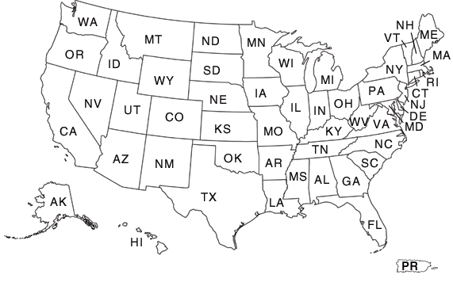
PHACS: US Findings

Slide 10
Rates of Mental Health Problems (MHP)
in PHIV vs HEU Adolescents(ages 7-16)
MHP were higher among PHEU (38%) than among
PHIV (25%) youth, p <0.01
Malee, Tassiopoulos, Huo, et al. Mental health functioning among children and adolescents
with perinatal HIV infection and perinatal HIV exposure. AIDS Care. 2011
Notes:
BIGGER FONT- JUST SHOW LAST COLUMN
MHP were higher among PHEU (38%) than among PHIV (25%) youth, p<0.01.
MH Problems across all domains- depression, anxiety, hyperactivity depression attention, aggression,
Overall MHP for entire cohort: 29%

Slide 11
Mental Health Diagnoses at Most Recent
Visit & Treatment in PHIV vs HEU Adolescents
(ages 10-22 years; mean=16 years)
* p < .04
Smith et al., Mental Health Diagnoses, Symptoms, and Service Utilization in US Youth with HIV Infection. CROI. 2018
Notes:
Primarily medical chart

Slide 12
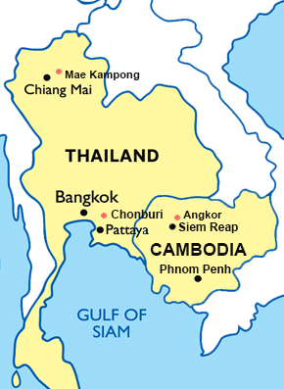
Resilience: Thailand and Cambodia

Slide 13
Mental Health Problems in PHIV and HEU
Adolescents (ages 10-22 years)
% of MH problems meeting clinical criteria at week 0 or 48
Kerr et al., Abstract #THPEB146; 22nd International AIDS Conference, Amsterdam, 2018
Songtaweesin et al., Poster #72, International Workshop on HIV Pediatrics, Amsterdam 2018

Slide 14
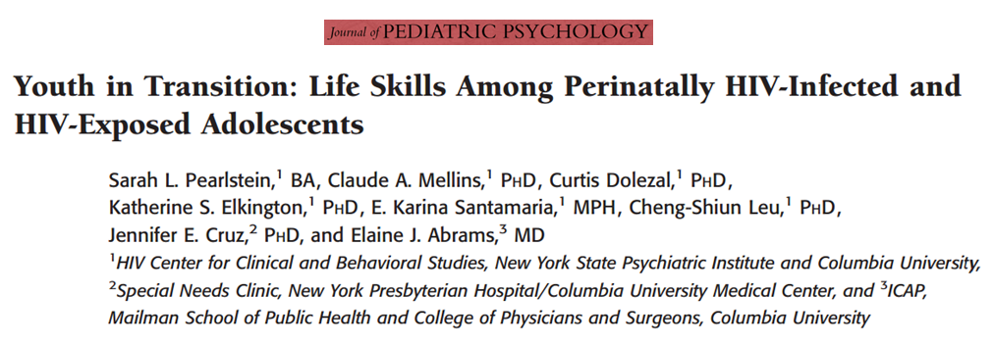





CASAH: Young Adult Transition Milestones
Childhood
Adolescents
Young Adulthood
Adulthood

Slide 15
CASAH: Young Adult Transition Milestones
(Ages 18-28 years; Mean= 22 years)
Abrams, Mellins, Bucek et al., Behavioral health and adult milestones in young adults with perinatal HIV infection or exposure. CROI. 2018

Slide 16
CASAH: Association of Disorders Among
Young Adult HEUs with Transition Milestones
Logistic Regression: Odds Ratio
Ever have Any Disorder | Working and/or in School
Any disorder | 0.672
Any psychiatric disorder (non-SUD) | 0.553*
Any anxiety disorder | 0.717
Any mood disorder | 0.460*
Any behavior disorder | 0.392*
* p <.05

Slide 17
Factors Related to Mental Health in
CASAH and PHACS
Adolescence
- Younger age
- Future orientation
Medical
Socio-economic Factors
- Caregiver access to resources
Mental Health
Family Systems
- Family functioning
- Caregiver-youth relationship, communication, involvement
- Caregiver mental health
- Family social support
Environment
- Less Neighborhood stress
Peers
- Better Peer norms re: substances and conduct
Stressful Life Events
- Fewer Major life events
(Bauermeister, 2009, 2012; Benson, 2016, Elkington, 2011,2014, 2015; Kang, 2012; Mellins, 2008, 2009, 2011,2016 ; Mutumba, 2016; Smith et al., 2018)
Notes:
Better Family Functioning (caregiver-youth relationship, communication, and involvement; family social support)
Less Neighborhood Stress, Fewer major life events
Better Caregiver mental health and resources:
Better peer norms (with Substance use)
Higher future orientation
Better mental health (no disorders is associated with lower rates of sexual risk behavior, fewer conduct problems
DATA SUGGEST opportunities for prevention and muli-system targets

Slide 18
Where Are We Now?
Eliminating vertical transmission of HIV
But HIV in women has been much more difficult to eliminate
Growing population of uninfected youth, perinatally HIV- and perinatally ART exposed
The long term impact of prenatal exposures particularly related to HIV and ART is still not known
Data from multiple studies across adolescent stages → risk for significant mental health problems with multiple potential causes of disorder
Yet, HEU youth are often invisible and vulnerable:
  Typically not followed by any system and often disconnected from care
But there is good news…..

Slide 19
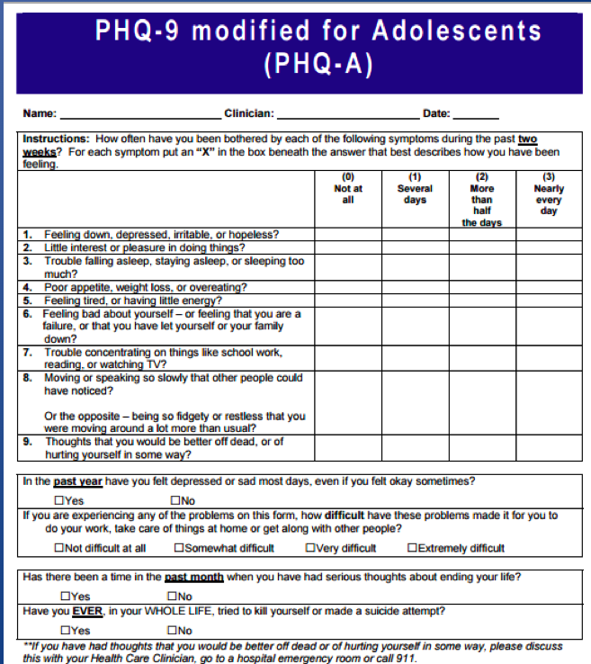

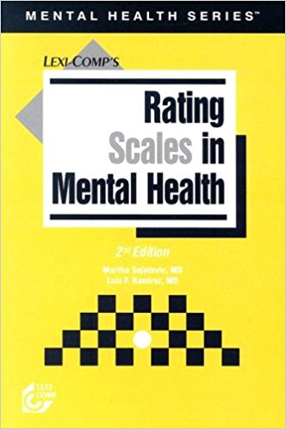
We Have Mental Health Screening Tools
State-Trait Anxiety Inventory for Children (STAI)
Patient health questionnaire (PHQ-9)
UCLA Child/Adolescent PTSD Reaction Index for DSM-5
Center for Epidemiological Studies depression scale (CES-D)
Generalized anxiety disorder scale (GADS)
Edinburgh postnatal depression scale (EPDS)
Hospital anxiety and depression scale (HADS)
Children’s depression inventory (CDI)
Hamilton rating scale for depression (HAM-D)
Revised Children’s Manifest Anxiety Scale (RCMAS)
Substance Abuse and Mental Illness Symptoms Screener (SAMISS)
Beck depression inventory (BDI)
Harvard trauma questionnaire (HTQ)
Kessler psychological distress scale (K10)
Strengths and Difficulties Questionnaire (SDQ)
Client Diagnostic Questionnaire (CDQ)
Source: Ali, PLoS One, 2016, “Validated screening tools for common mental health
disorders in low and middle income countries: a systematic review; and Mellins, Ng et al., 2018
Notes:
Similarly, we have a wide array of Mental Health Screening Tools that are being used in clinical care as well as in research. GET RID OF ANIMATION
CLICK 3 TIMES
And these have been validated in low- and middle-income countries
CLICK

Slide 20







We Have Mental Health Treatments
Psychopharmacological (Psychotropic medications)
Psychotherapies
  Psychodynamic
  Cognitive-behavioral therapy (CBT),including Trauma-focused CBT
  Motivational enhancing therapy (MI)
  Stress-reduction / Mindfulness interventions
  Harm-reduction and abstinence treatments
  Interpersonal therapy (IPT)
Manualized and tailored across languages and cultures
  Trials with populations living with HIV
  Some have been adapted for use by lay counselors
  Some being tested using different technologies (e.g., phone, internet) for scale-up
Slide from Remien RH, CROI, 2018
Notes:
We most certainly do have effective mental health treatments, including
CLICK 5 TIMES: Psychopharmacological interventions, an array of Psychotherapies, Stress-reduction interventions, and harm-reduction and abstinence interventions for alcohol and other substance use
And these are manualized and tailored across languages and cultures – thus, capable of being scaled up; and Technology is being used as part of that scale-up
CLICK

Slide 21
Challenges
Mental health treatment in the context of significant economic and social disadvantage
  It’s hard to pay attention to mental health when
  basic living needs or health are challenged
  However, mental health problems can preclude young people being able to get their health and basic living needs met
Self-
Actualization
Esteem
Belonging
Safety
Physiological
Notes:
THE ANIMATION IS OFF_ Maslow should come in with first second bullet
Picture of silos maybe after second bullet?
One pill vs multiple pills for third?
We have a lot of knowledge from HIV- like integrated care, mulstidisciklpiinary care,
Cautionary note- going to take more than 3 sessions- there is not one magic pill- lets not fool ourselves

Slide 22
Challenges
Youth have needs across multiple domains and our interventions are often siloed- e.g. medical, mental health, educational, vocational, or economic → need for multidisciplinary, integrated care
There may not be one magic pill or quick fix- brief interventions often have short term effects → may need longer term interventions
ACCESS!!

Slide 23
We Need Treatment Programs
But There are Global Treatment Disparities
90% of children and adolescents live in LMIC
But only 10% of RCTs on child and adolescent mental health treatment done in LMIC
Kieling et al., 2011
Notes:
Data also indicate- that there are substantive mental health needs
But there are Global treatment disparities
Children and adolescents= approximately 1/3 of the world’s population
90% live in Low-income and middle-income countries
While evidence based interventions have been developed and tested in high income countries, limited work where the majority of children live- only 10%

Slide 24
What We Need Now
Establish systems to identify and follow uninfected children born to women living with HIV
Increased studies that go beyond identifying needs
  Increase understanding of the unique role of HIV exposure and ART exposures on youth and young adult development in conjunction with other risk factors
  Identify appropriate adolescent treatments and scalable means of using them (e.g., communities, technology)
Evaluate on a global level
“The roadblocks lie on the path between knowing what works …. and how it will be delivered…to scale —that is, to entire populations.”
    -Patel, Flisher, Hetrick, and McGorry, 2007
Notes:
THIS may be more of a picture
Fix BULLETS

Slide 25
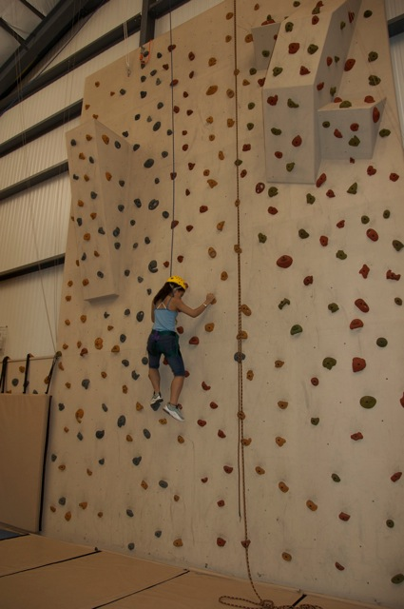
A Challenge We Need to Conquer
THANK YOU!
Notes:
Feels like a big wall to climb

Slide 26
It Takes A Village: Collaborators
CASAH
Elaine Abrams, MD
Rehema Korich, MPH
Jeannette Raymond
Katherine Elkington, PhD
Cheng-Shiun Leu, PhD
Curtis Dolezal, PhD
Andrew Wiznia, MD
Mahrukh Bamji, MD
Patricia Warne, PhD
Amelia Bucek, MPH
Reuben Robbins PHD
PHACS
Kathleen Malee, PhD,
Renee Smith, PhD,
Russell Van Dyke, MD,
Susannah Allison, PhD,
Rohan Hazra, MD,
Pim Brouwers, PhD,
George R. Seage, DSc,
Ellen Chadwick, MD
Paige Williams, PhD,
Katherine Tassiopoulos, DSc
Resilience
Jintanat Ananworanich, MD, PhD
Stephen Kerr, PhD
Kathleen Malee, PhD
Thanyawee Puthanakit MD
Natalie Wipaporn Songtaweesin, MD
Robert Paul, PhD
Tulathip Suwanlerk, MSc
Jiratchiya Sophonphan, MSc
Pope Kosalaraksa, MD
Kulvadee Thongpibul, PhD
Pradthana Ounchanum, MD
Linda Aurpibul, MD
Suparat Kanjanavanit, MD
Chaiwat Ngampiyaskul, MD
Kea Chettra, MD
Penh Sun Ly, MD
Other
Leigh Reardon, MPH
FUNDERS: NIH (NIMH, NICHD)
Youth and their families affected by HIV who gave us considerable time and their wisdom

